Slide 1
sYMBOLS
SEQUENCE OF EVENTS

Slide 2
SYMBOLS
The Great Sleep
furniture
Jack’s “Great Sleeps” which bear some resemblance to depression marks great disturbing changes in his life.
SYMBOLIC MEANING: represents his handling personal challenges – disappearing from them
Jack’s mother is constantly buying furniture.
SYMBOLIC MEANING : lack of connection with her own impoverished past.

Slide 3
symbols
drinking
Tom stark
Drinking, more than anything, is used to symbolize the change in Willie.
Tom symbolizes the consequences of corruption and the hunger for power. The very thing that makes him a golden-boy superstar –football –causes his destruction.
He is shielded and enabled by Willie.

Slide 4
The Ring
The meaning of the ring evolves during the course of novel. Literally, the ring is Duncan Trice's wedding ring. At first the ring signifies what Duncan intends, specifically an accusation by him of Annabelle's betrayal by having an affair with Cass. Upon seeing the ring Annabelle knows Duncan killed himself because he found out about her infidelity. However, the ring soon takes on a broader meaning. Annabelle's slave, Phebe, found the ring and showed it to her. Annabelle notices how the golden color of Phebe's skin matches the color of the ring. The ring, therefore, represents the unity of knowledge between Phebe and Annabelle: they both know why Duncan committed suicide. Annabelle, though, cannot abide sharing such scandalous knowledge with a slave, feeling that Phebe will always have something over her. So Annabelle sells Phebe. However, the ring also represents a deeper unity: Phebe and Annabelle are connected as human beings. Annabelle subconsciously realizes this, which also causes her to cast out Phebe. Like Caroline Turner, Annabelle cannot stand viewing Phebe as a fellow woman. Doing so would compel her to realize how she has abused Phebe by treating her as a slave. This deeper meaning, though, is not lost on Cass.
Annabelle puts the ring on Cass, wanting to signify how her union with him replaces her marriage to Duncan. However, after hearing how Annabelle sold Phebe, Cass is horrified. The ring becomes a symbol of his interconnectedness with Duncan and Phebe. Cass knows because of his affair with Annabelle that he caused the death of his friend Duncan and the sale of a slave. As he searches for Phebe, the ring takes on a broader and deeper meaning for Cass. He is exposed to the system of slavery, which involves white people abusing female blacks on the auction block, treating them as objects. He understands that he is part of a corrupt, evil system that is causing the suffering of millions of people. Cass shows the significance of the ring to him by wearing it on a cord around his neck. Because the ring represents the union of all people, it ties in directly to the spider web analogy, which claims that everyone in the world is interconnected like a spider's web.
The ring is passed on to Jack Burden when he is a college student. He probably senses its deeper meaning and, because of this, pushes aside his research of Cass and anything else dealing with the ring. At this point in his life Jack refuses to take responsibility for his actions, so Cass's story and the ring will not be a reproach to him.

Slide 5
Roar of the crowd
Warren uses the roar of the crowd to represent how the adoration of the people can raise a person to a godlike status.
When Willie gives a speech on the steps of the Capitol building, he hears constant chants of "Willie, Willie." The crowd gives their unconditional support and love to Willie. They see him as a savior who can do no wrong. The roar of the crowd, therefore, empowers Willie, giving him freedom. Throughout the novel Warren shows the danger of such adoration. Backed by the people, Willie feels free to use bribery and blackmail to achieve his goals. He has affairs with many women, showing no respect for his wife. Willie sees himself as above the law and a law unto himself. Also Willie uses the roar of the crowd to confirm his own righteousness. The crowd loves the results he achieves and doesn't seem to care how he achieves them, so his corrupt approach must be correct. Willie convinces himself he must be a savior. His use of religious language during his speech, such as "O Lord," and "I have seen a sign," shows this.

Slide 6
Willie’s hospital
Willie's hospital symbolizes how Willie uses good achievements to justify his corruption.
Throughout his terms as governor Willie claims a person needs to use corruption to accomplish anything worthwhile. Because people are basically sinful and corrupt, a person has to use this corrupt material to achieve goodness: there isn't anything else to make goodness out of. To justify this approach Willie plans to build a great hospital that almost seems like heaven on earth. Willie says he's going to build the "biggest, chromium-platedest, formaldehyde-stinkingest free hospital ... the All-Father ever let live."

Slide 7
WEST AND SECRET KNOWLEDGE
Jack is all about "secret knowledge," and he thinks the Big Twitch is the ultimate in secret knowledge. So much so that he has to go all the way to Long Beach, California to get it. This is part of American mythology: going west to fulfill your dream.
Jack is "drowned" in these dreams, "drowned in West," and reborn into somebody who can't be hurt by the world in which he has to live and work (7.187). This leads to the Great Twitch, but also to a fearlessness and resolution in his search for the truth.
It's also kind of funny that Jack is so excited about having secret knowledge, and finally not having to "envy" other people that have secret knowledge. Isn't that what he always has? Isn't that what he does for a living? Isn't that what sent him hurtling west "doing seventy-five" in the first place? (7.1)

Slide 8
SEQUENCE OF EVENTS
THE ORDER OF EVENTS WHICH AFFECT THE PLOT DEVELOPMENT IN THE STORY

Slide 9
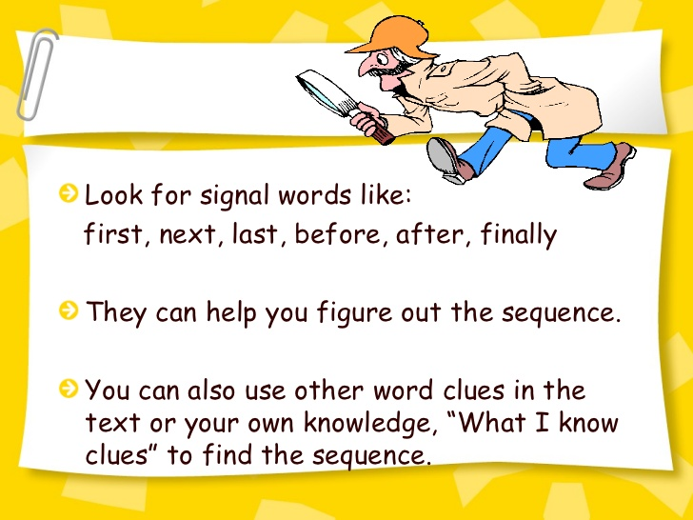
Sequence of events
Refer to Handout.
Describe the chronology events under each MAIN HEADING. Identifying the sequence of events in a story means you can pinpoint its beginning, its middle, and its end. Once you can identify each of these core components, you can retell the story in the order in which it occurred. Sequencing is a key component in reading comprehension. It also allows readers to synthesize information and order it accordingly.
Jack’s Events
Hotel Disaster
Impeachment Proceedings

