Slide 1
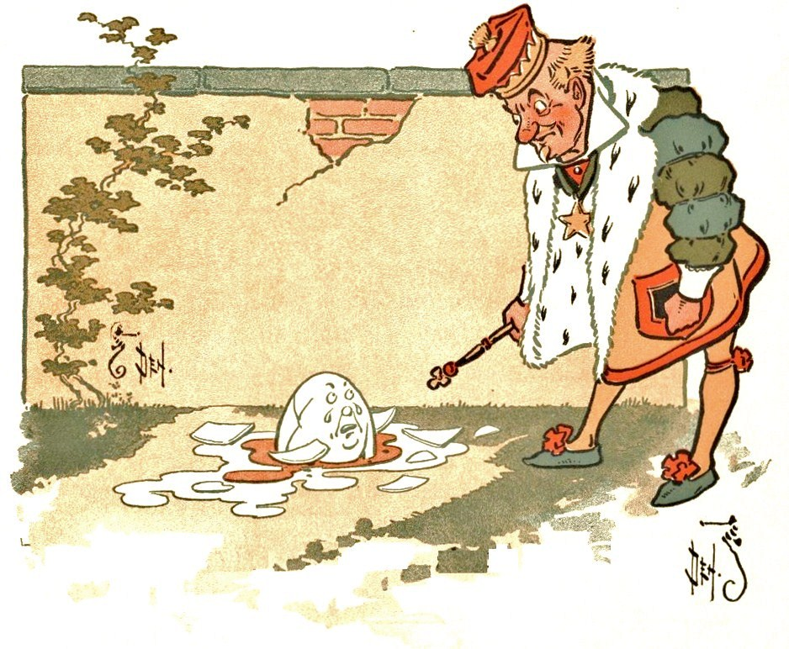
Burden of History

Slide 2
BURDEN OF HISTORY
Warren sees history as ana ctive part of the present, rather than something in the past that has no effect on people.
The author shows this through his style by interweaving past events, showing their effects on current actions.
The past affects people’s actions,
which have mixed results

Slide 3
EXAMPLES
Example: when Jack Burden learns about the history of his ancestor Cass Mastern, this knowledge has an effect on his actions. Jack attempts to push aside taking responsibility for his past by using various techniques, like the Great Sleep and the Great Twitch, but even so he ultimately can not deny that the past is always with him
Example: Because Jack’s ability to recall the bast, he knows his revelation about Anne’s father’s scandal resulted in her later affair.
Example: Jack’s inability to reflect on the past, including personal history, disproves his Great Twitch Theory.

Slide 4
Through reflection about history, Jack understands that past events form a pattern or web with on event interacting with other events, Because of this,each current action is influenced by previous actions and has future repercussions.
Jack decides to take responsibility for his actions by accepting his past and its burdens. This will allow him to accept responsibility for future plans.

Slide 5
Warren views history as a BURDEN because of the mixture of good and evil.
A person take what hew or she might consider to be positive action, but it may have unintended negative results or mixed results. For example, Anne tells the truth to Adam abou the father’s scandal with the hope that this information might convince him to take the job running the hospital. Anne wants Adam to accept this job because of the good he can do through it. To a certain extent Anne’s attempt works as planned. Because his own family is not free from corruption, Adam realizes he has no right to refuse associating with the corrupt Willie. So he takes the job.
Therefore by engaging in world events, a person must accept the burden of history that his or her actions often have mixed results.

Slide 6
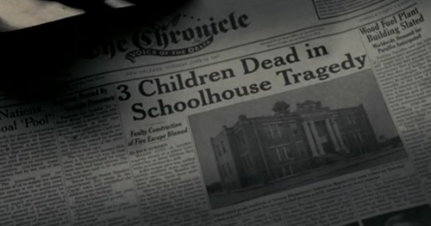

Event of the School House Bid
Refer to Chapter 1 and 2. FOCUS on the school house bid and its effect on the historical development of the novel.
Explain what is the School House bid event?
Who was involved?
What was the result of Willie’s support in the school house bid?
What happened as a result of the project?
How does this change the result of history?

