Slide 1

Fishbowl
Discussions
Questions
and Guidelines

Slide 2

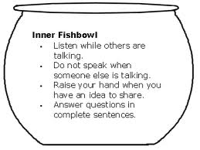
Background Knowledge on the Fishbowl
https://rpscurriculumandinstruction.weebly.com/tools-tips--tricks/fishbowls

Slide 3
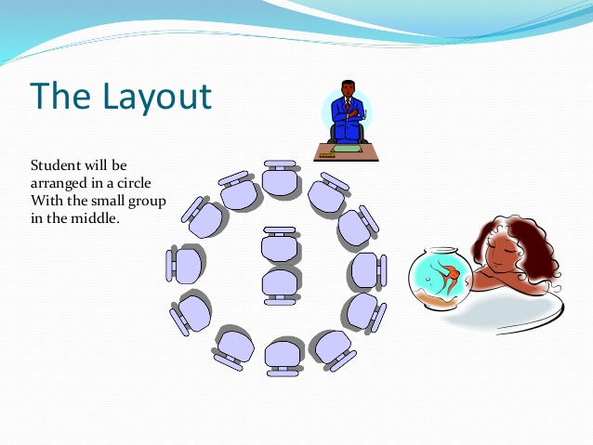
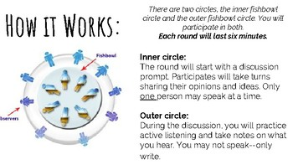
Background Knowledge on the Fishbowl

Slide 4
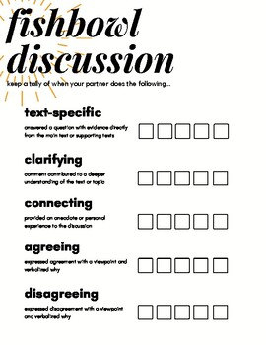
proof.
Fishbowl Questions
Fish Bowl Questions- Chapter 1 1- “Man is conceived in sin and born in corruption.” – how do you think this quote foreshadows the dramatic conclusion 2. Discuss flashback. Where in the chapter does this occur? 3. Inner conflict which occurs with Jack and why? 4. Cite evidence of political moves in this chapter. 5. How is the theme of personal responsibility linked to the burden of history with the character- Jack. Cite examples. 6. How is the theme of father and sons evident. Cite

