Slide 1
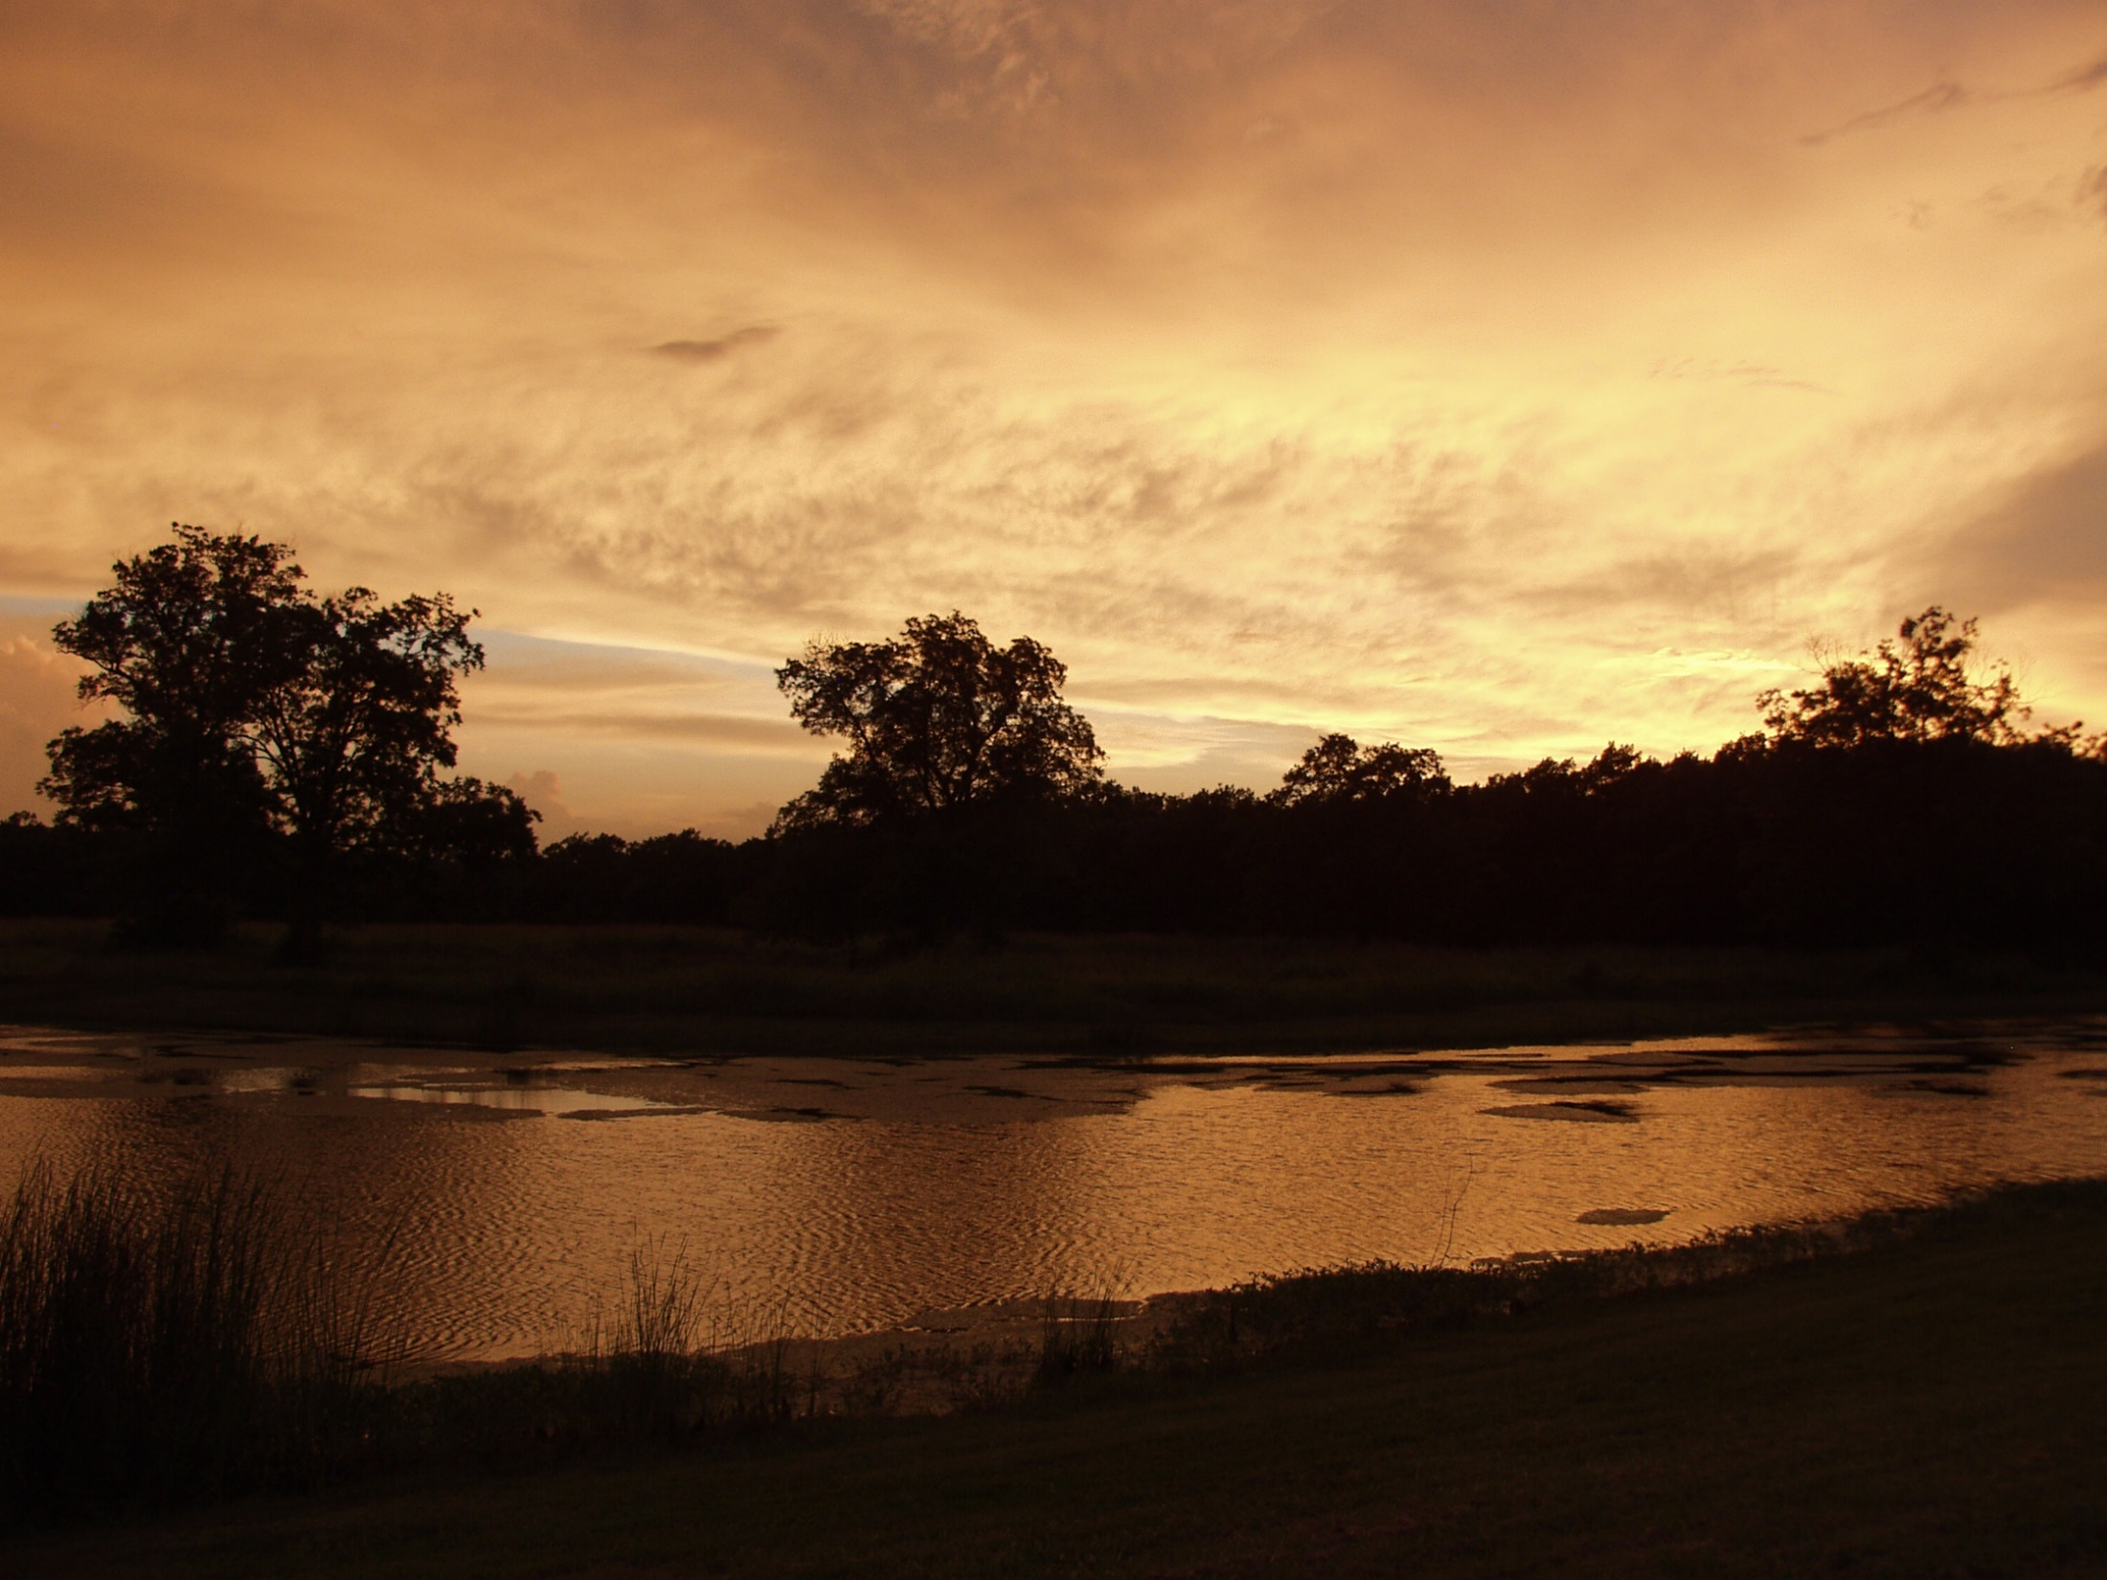
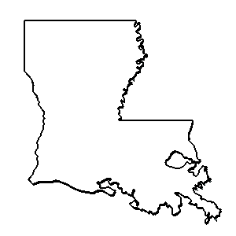
ouisiana
Anthology

Slide 2
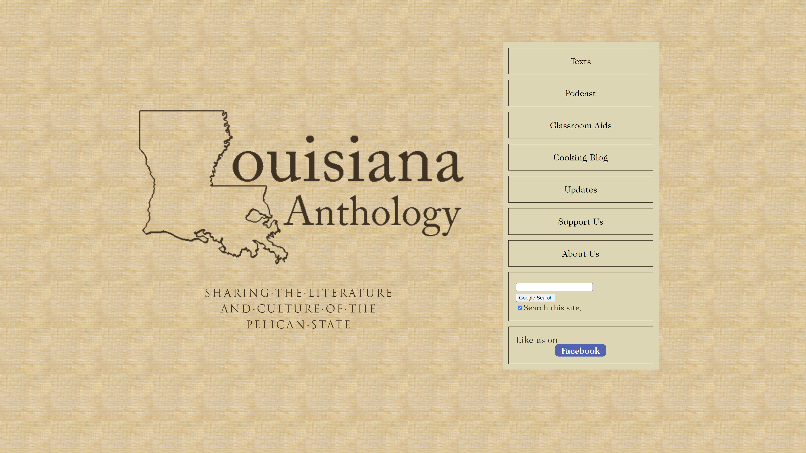

Slide 3
“The Ursuline Correspondence.”
Bruce R. Magee & Stephen Payne

Slide 4
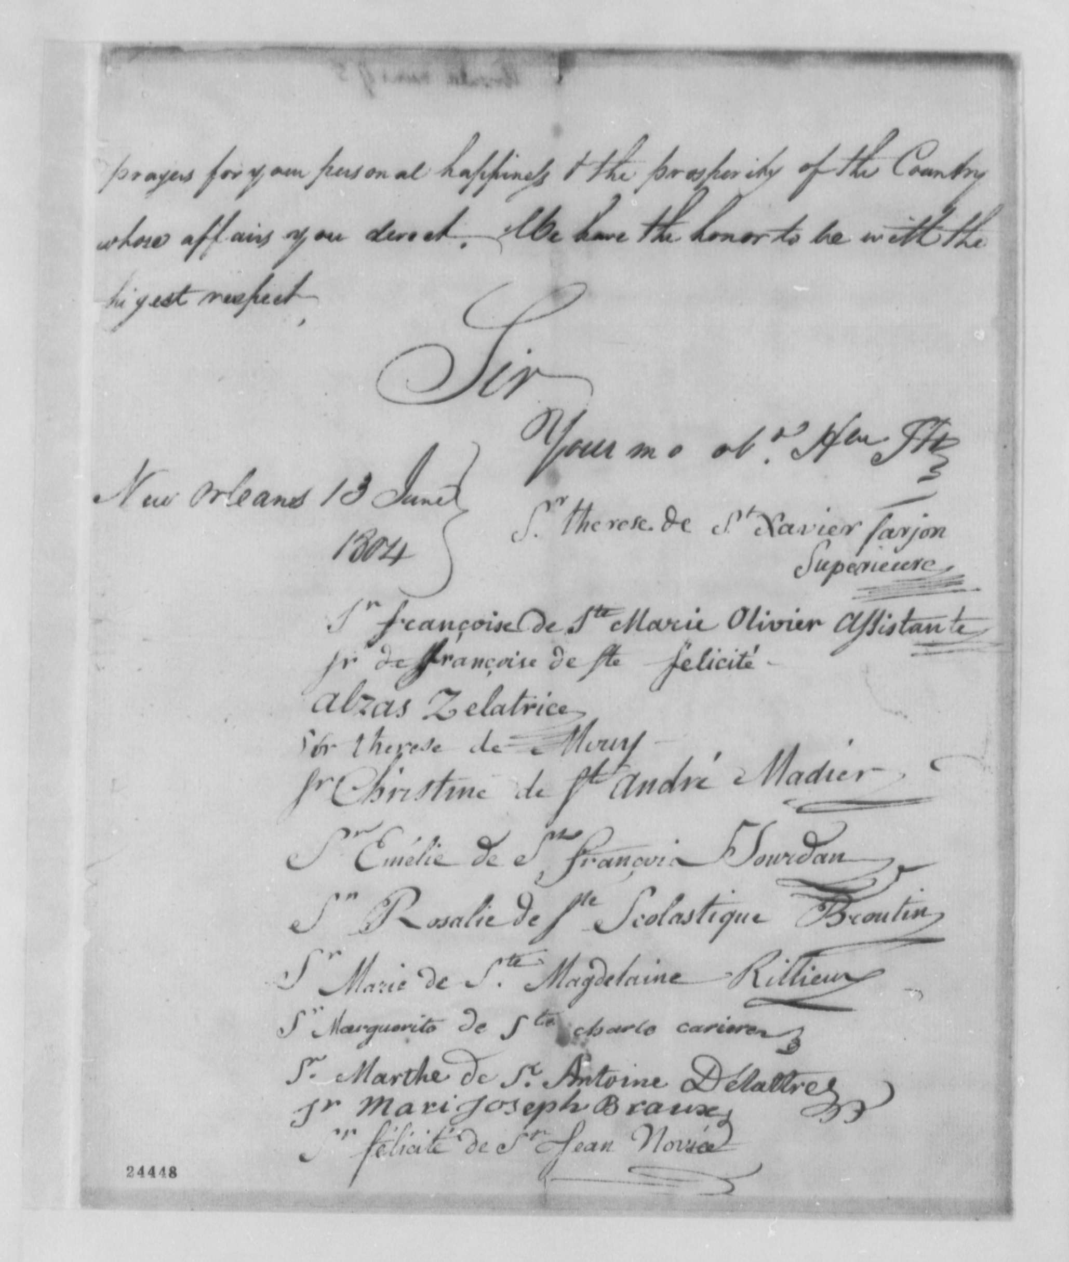
1.
Ursuline Petition
June 13, 1804

Slide 5
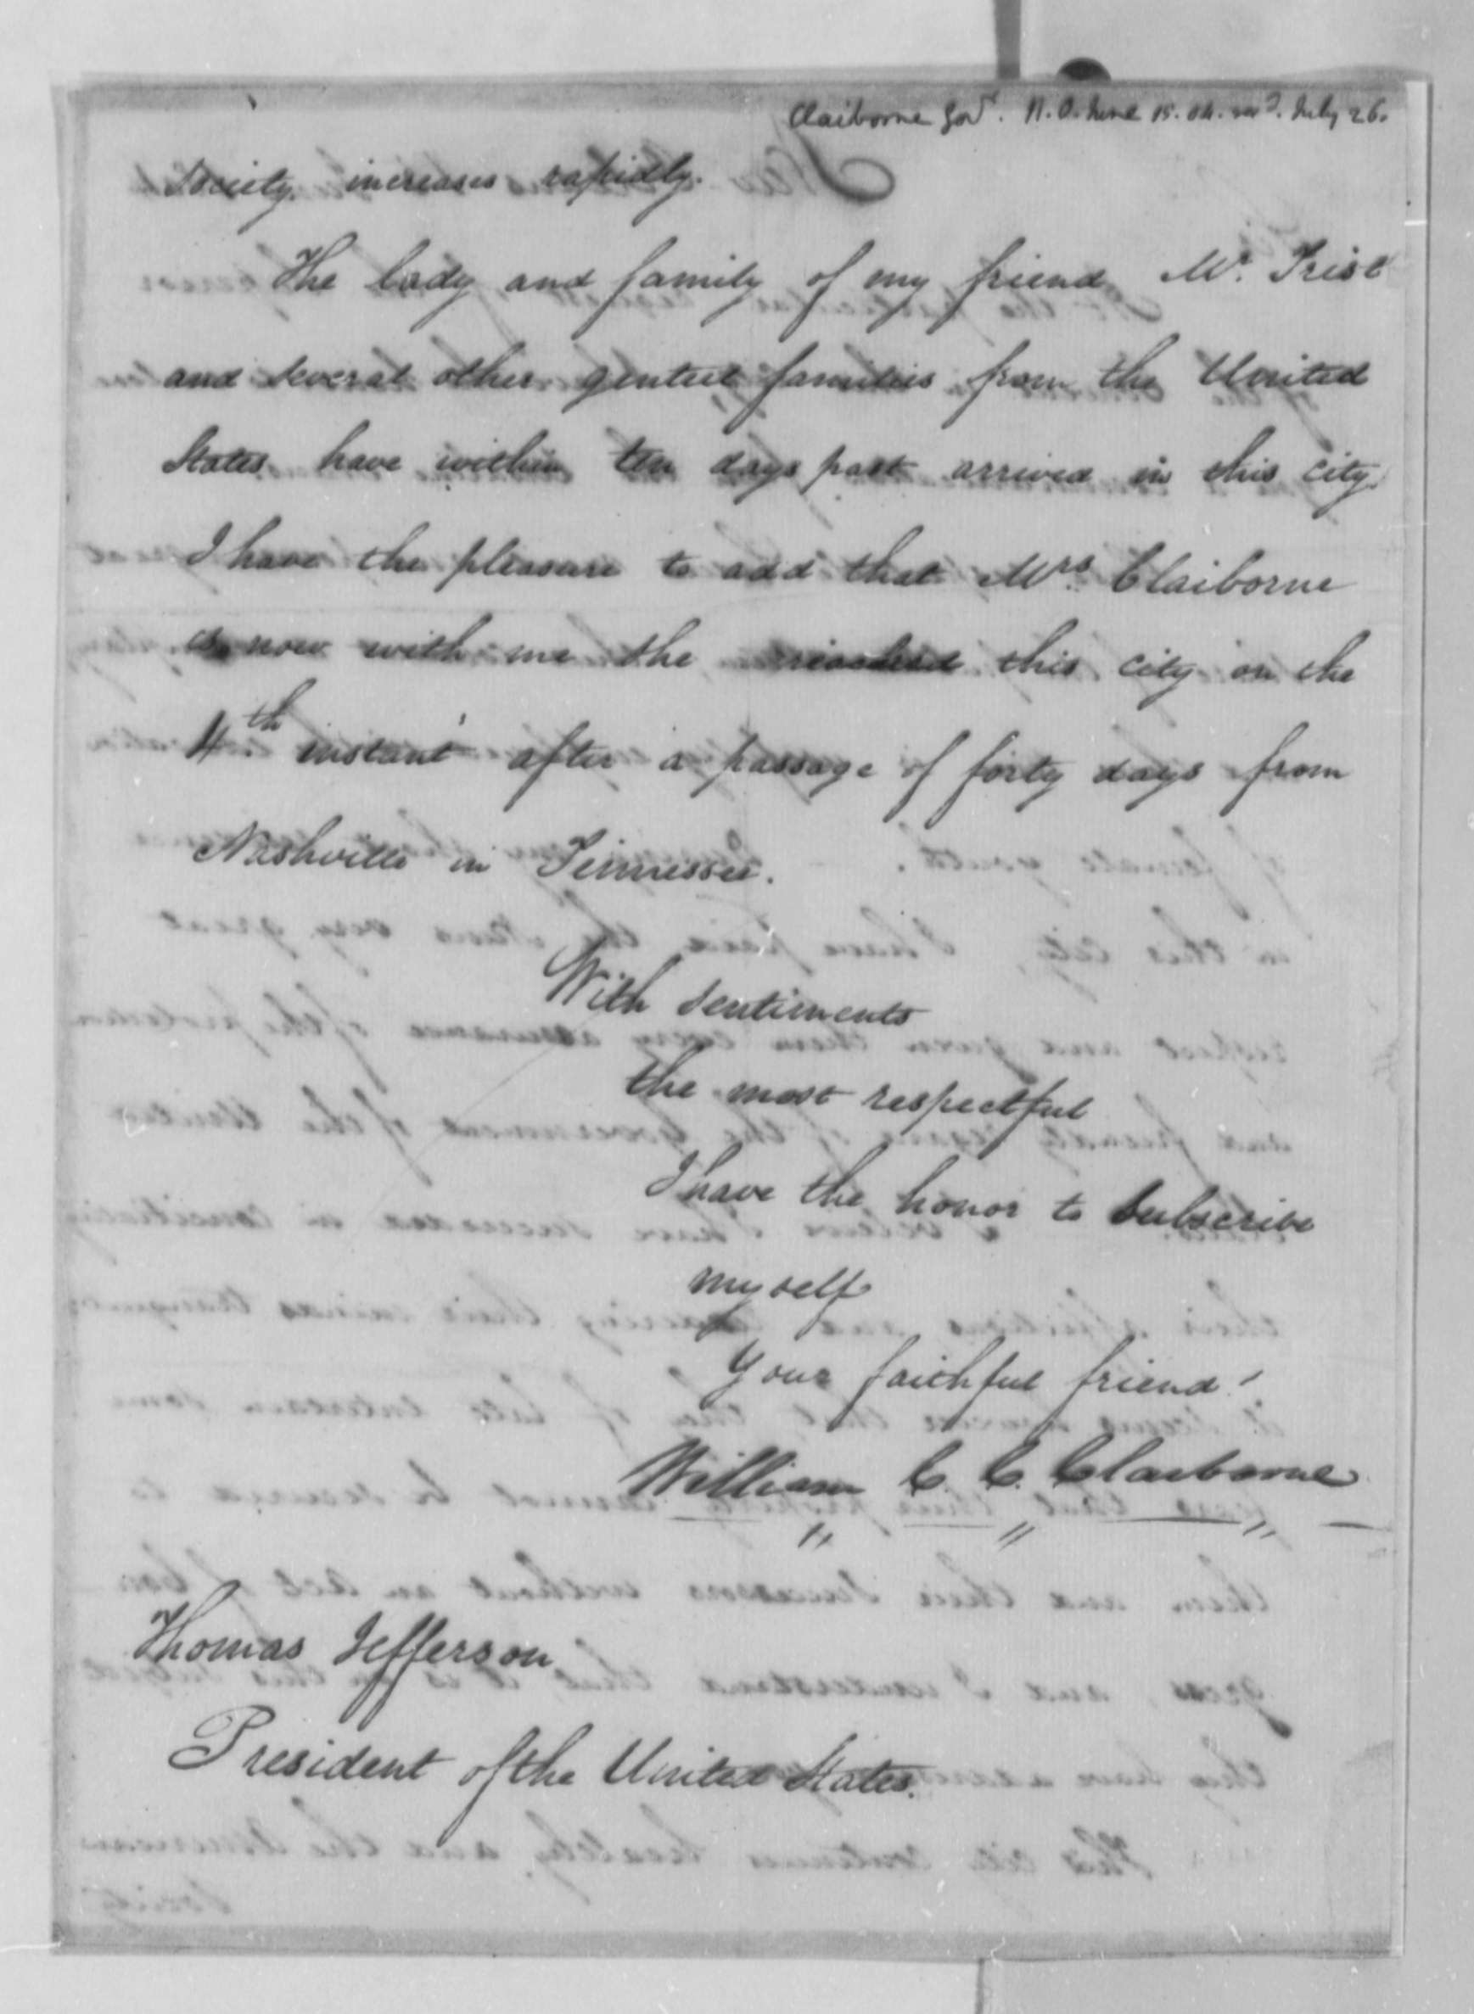
2.
Gov. Claiborne’s
Cover Letter
June 15, 1804

Slide 6
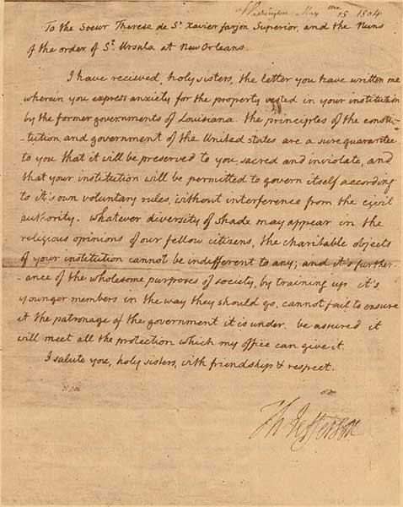
3.
Pres. Jefferson’s
Reply 13 or 15 July, 1804

Slide 9
I. Occasion.

Slide 10
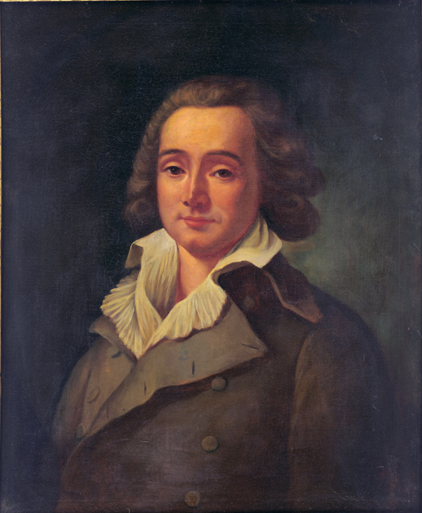
Prefect Pierre-Clément de Laussat Retrocession to France March 1803
4 of 26 priests remained.
9 of 25 Ursulines stayed. The rest fled to Cuba. Therese Farjon was elected Mother Superior. June 10, 1803 (Rodda).

Slide 11
Why were the nuns worried?
1755. Grand Dérangement. 1765. The nuns helped the Acadian exiles.
1776-1784. The American Revoltion.
1789-1799. French Revolution.
1791-1804. Haitian Revolution.

Slide 12
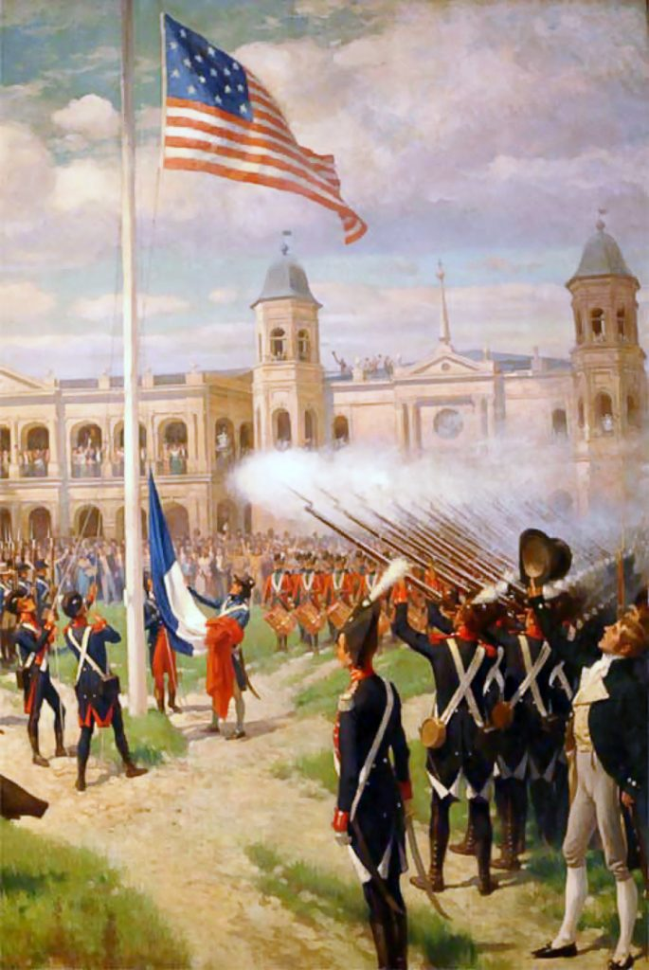
Louisiana Purchase Ceremony December 20, 1803
“Rumour the swiftest of all evils” (Virgil).
The USA was planning to confiscate the convent’s property and deport the nuns.
The USA would prohibit new nuns in the convent & confiscate their property when the nuns died (Rodda).

Slide 13
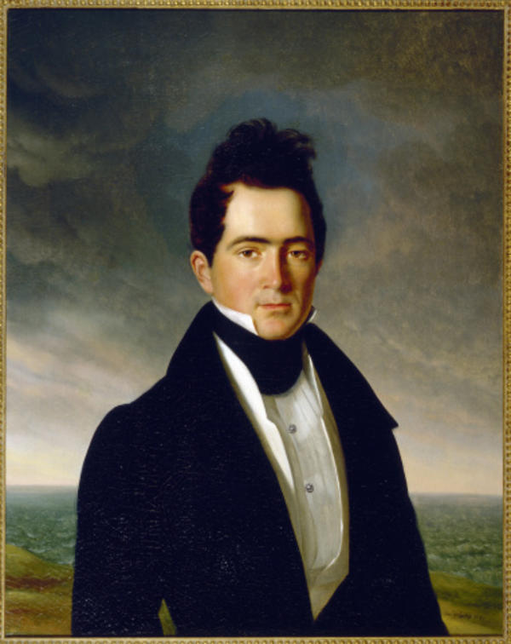
Claiborne tried to reassure the nuns, but their concerns resurfaced when the district commandant temporarily closed a Catholic church to quell a dispute between 2 rival priests and their adherents.
Gov. W.C.C. Claiborne

Slide 14
II. Purpose.

Slide 15
Ethos—Respectability Politics
…it is the cause of the Orphan, of the helpless child of Want, of the many who may be snatched from the paths of vice & infamy under their guidance. & be trained up in the habits of virtue & religion to be happy & useful, — of society which will be spared the burthen of the indigent & the depredations of vice — of their country itself which cannot but acquire honor in fostering & protecting such beneficent purposes.

Slide 16
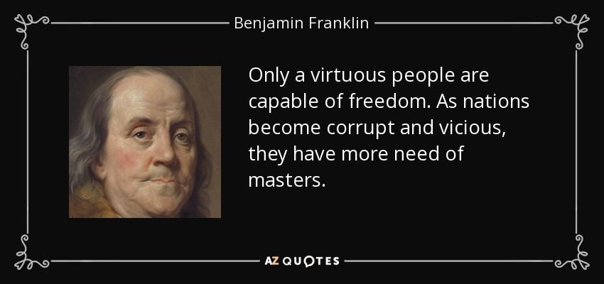
A lady asked Dr. Franklin, “ Well Doctor, what have we got, a republic or a monarchy?”
“A republic,” replied the Doctor, “if you can keep it.”

Slide 17
The Request
they believe that without any direct application, the treaty of Cession, and the sence of Justice which marks the character of the United States, would have secured to them the property they now possess, but considering a sacred deposit, they would fail in a duty they deem essential were they to ommit requesting, that it may be formally confirmed to them & their successors, & that you may be pleased to communicate this request to the Congress of the United States in such a manner as you may deem proper —

Slide 18
Keep their property.
Continue to educate girls.
Add new nuns to the convent.

Slide 19
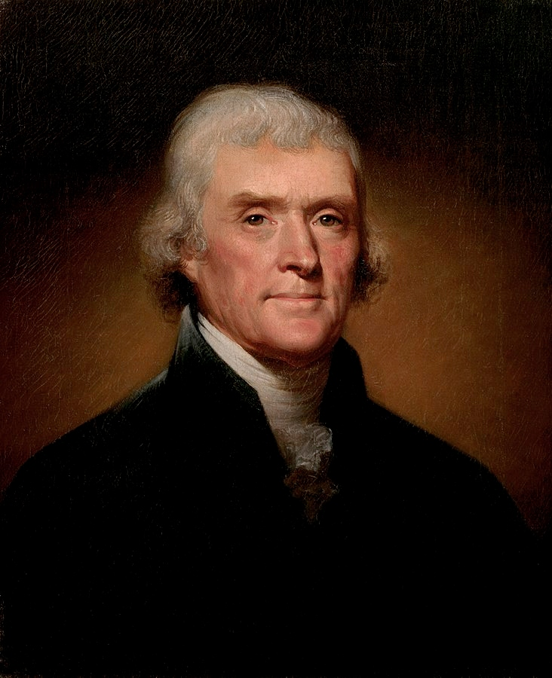
Thomas Jefferson’s Reply

Slide 20
The First Amendment
I have recieved, holy sisters, the letter you have written me wherein you express anxiety for the property vested in your institution by the former governments of Louisiana. the principles of the constitution and government of the United states are a sure guarantee to you that it will be preserved to you sacred and inviolate, and that your institution will be permitted to govern itself according to it’s own voluntary rules, without interference from the civil authority.

Slide 21
Respectability Politics
…whatever diversity of shade may appear in the religious opinions of our fellow citizens, the charitable objects of your institution cannot be indifferent to any; and it’s furtherance of the wholesome purposes of society, by training up it’s younger members in the way they should go, cannot fail to ensure it the patronage of the government it is under. be assured it will meet all the protection which my office can give it.

Slide 22
III. Outcomes.

Slide 23
1818.
The Louisiana State Legislature recognizes the Ursulines as members of a religious institute and affords them rights and privileges.

Slide 24
December 6, 1865.
The 13th Amendment is ratified, freeing the Ursulines’ slaves.

Slide 25
